Slide 1
MicroServices
Cole Danbury

Slide 2
About Me
Former Computer Engineering Major at Wright State University, and afterwards transitioning to a back-end developer for the Platform team at Winsupply. Currently, I focus on the application control and utilities of WISE and other critical applications at Winsupply.
Linkedin: https://www.linkedin.com/in/cole-danbury-70347714b/

Slide 3
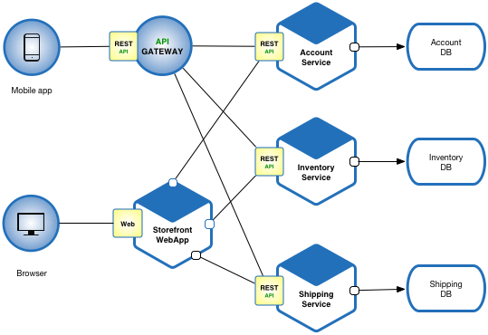
Scope Setting
Where do microservices come into play?
Microservices vs Monolith
Microservice vs web app vs database
More information about restful apis: https://restfulapi.net/
Notes:
1. ) Where the business logic of applications live. Houses critical decision making code as well as security, and database interactions.
2.) Single app vs smaller individual applications. Maybe ask the students if they can think of advantages and disadvantages to each
3.) Not a perfect picture, but good enough for our purposes. Pay attention to flow of http request from webapp to service to db and back.
4.) we design restful api’s at winsupply. They are useful for intuitive applications that are easy for users to operate.

Slide 4

What is a Spring Boot?
Spring vs Spring Boot: https://www.baeldung.com/spring-vs-spring-boot
Where do the dependencies come from?
What does it make easy?
Notes:
Firstly, any questions? What is some benefits of spring boot? Where do all the goodies (dependencies) come from?
How does the database get connected? Spring helps wrap the gradle dependencies, database, and common rest api design patterns. Due to the amount of code it helps you not write, it can save a lot of time and makes the framework really compatible with microservices.

Slide 5
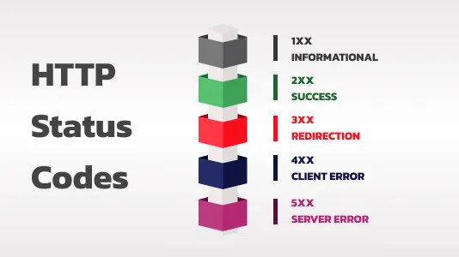
Http Status Codes
Notes:
Most common codes: 200, 404, 400, 403, and 5xx requests. They give you clues as to what can be going wrong in an application!
Don’t worry about memorizing all of them. I haven’t :D
2xx everything is okay
4xx user error. Wrong payload options or wrong pathing or… wrong credentials! 5xx service error, check the app! This is important with regards to exceptions as well. Exceptions are a normal part of application development flow. The most important thing for us to do is handle them in an intuitive way that explains to the developer (and user) what the cause of the error is.

Slide 6
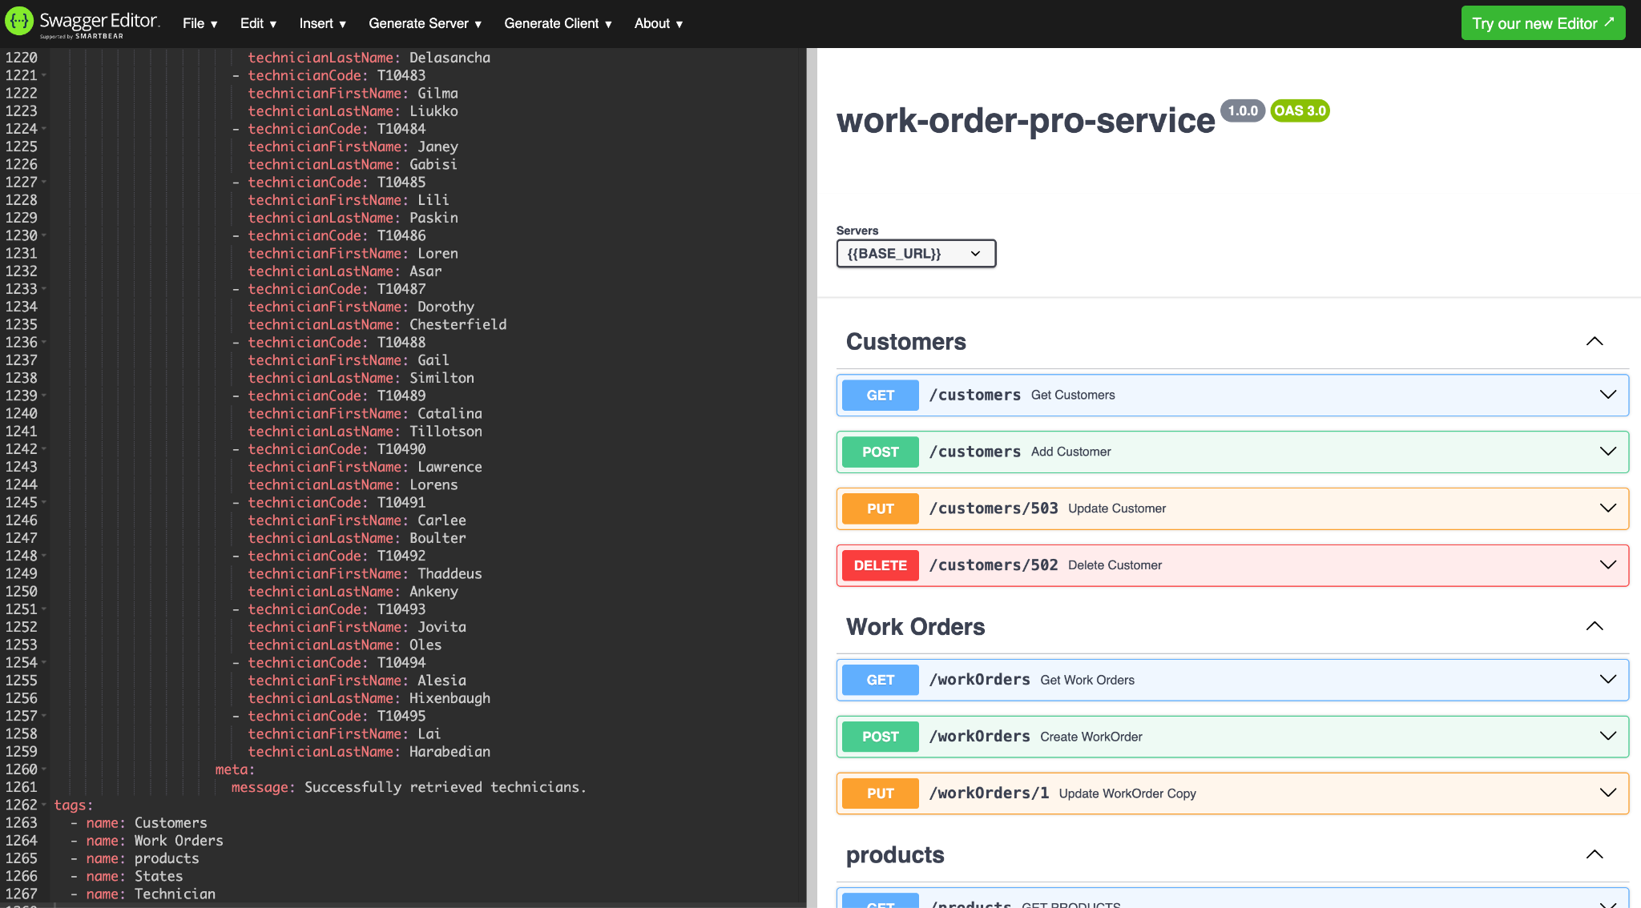
Let’s take a look at WOMS
Notes:
Take a second to talk about endpoint design - nouns for endpoint names that represent resources and the Http Requests that correspond to each endpoint. Which kind of Http request would you expect to have a request body? Bring up passing a request body with a POST request. It’s normal behavior because that’s what POSTs do! Bring up pathing when it comes to updates. This is an alternative way to get the data than passing it as a request body.

Slide 7

Questions?

